Slide 1



Sales Performance Dashboard
Author: Ammarah Khan

Slide 2

CONTENTS
1. Introduction
2. Key Performance Indicators (KPIs)
3. Sales Over Time
4. Top Products
5. Regional Performance
6. Sales Representatives
7. Category & Customer Type
8. Discounts & Net Sales
9. Recommendations
10. Appendix

Slide 3


01
Introduction

Slide 4
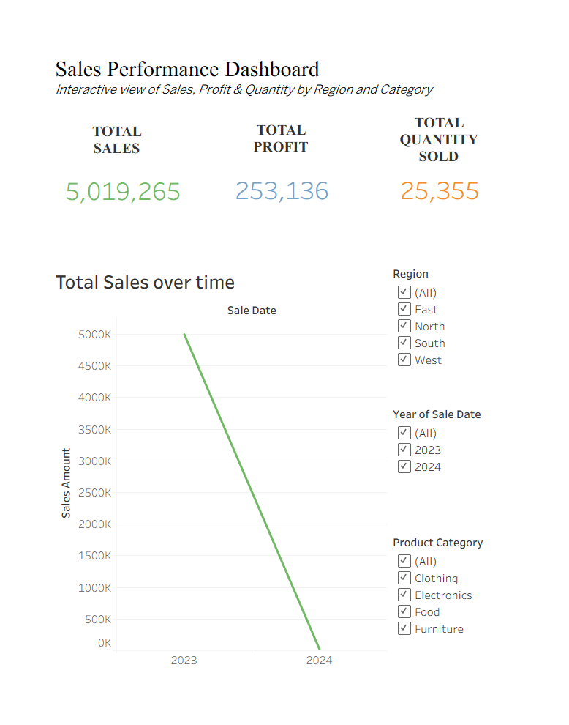
Overview
Subtitle: Interactive view of Sales, Profit & Quantity by Region and Category
Footer: Dataset: Kaggle – vinothkannaece/sales-dataset.

Slide 5

02
Key Performance Indicators (KPIs)

Slide 6

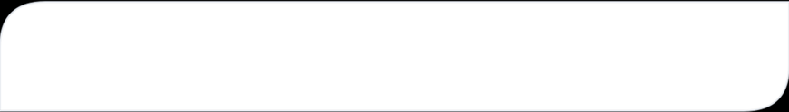
Summary of KPIs
Total Sales
5,019,265
Total Profit
253,136
Total Quantity Sold
25,355
Note: Values as shown on the dashboard.

Slide 7

03
Sales Over Time

Slide 8
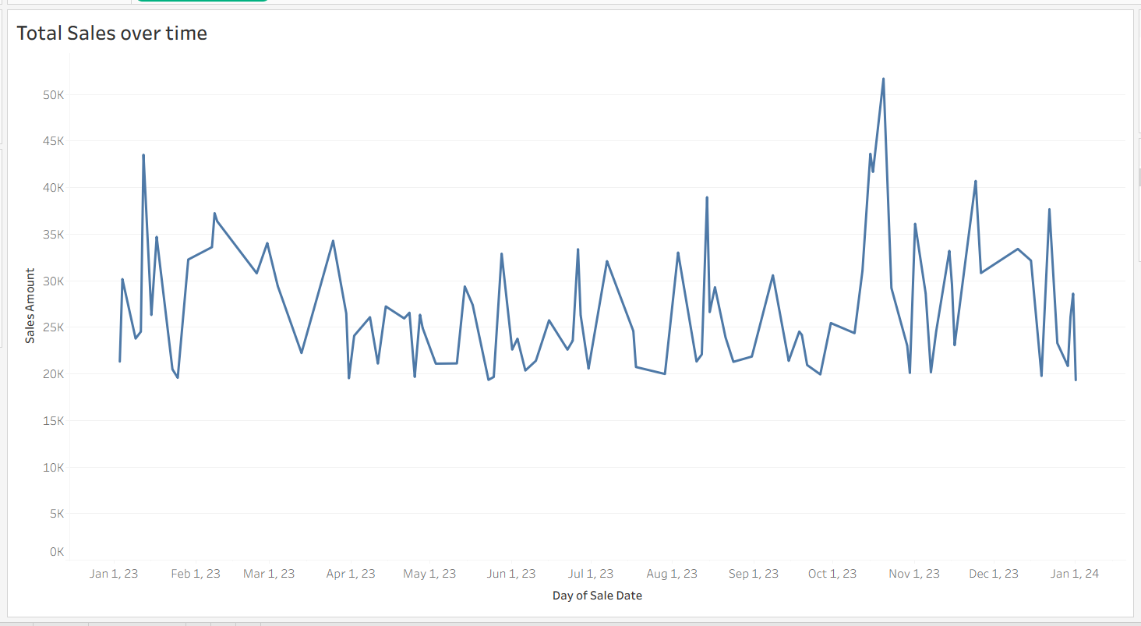
SALES OVER TIME
Observation: Sales decline observed from 2023 to 2024 — check data & seasonality.
Recommendation: Investigate root causes and review promotions/inventory.

Slide 9

05
Regional Performance

Slide 10
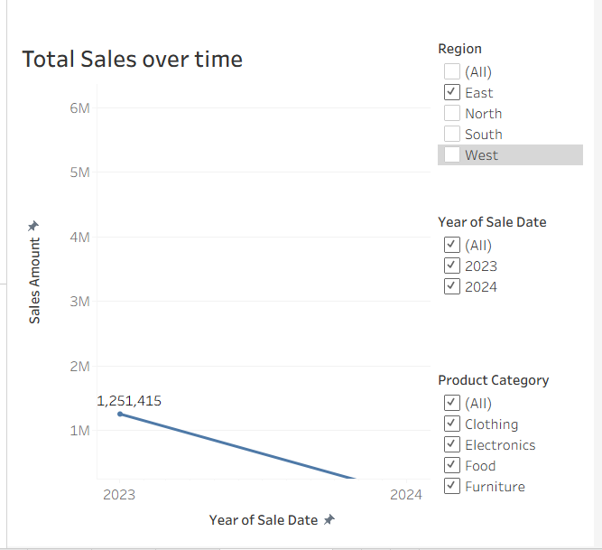
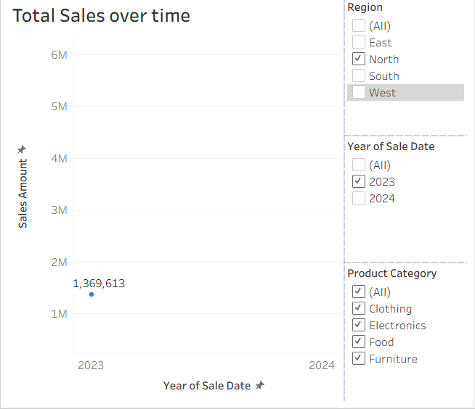

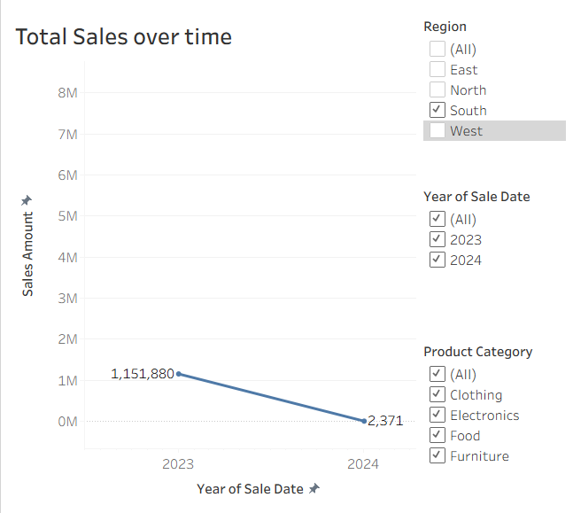
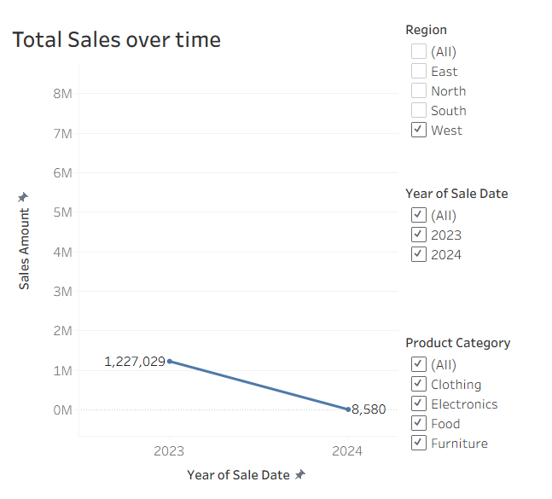
Regional Analysis of 2023
Observation
[Region SOUTH] highest SALES; [Region EAST] lowest.
Recommendation
Redirect advertising to underperforming regions.

Slide 11

07
Category & Customer Type

Slide 12

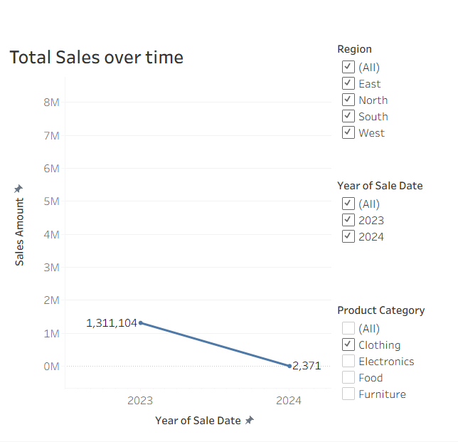
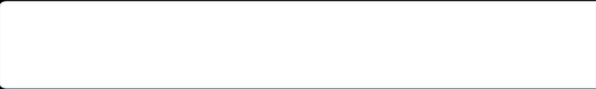
Revenue Insights
Observation
CLOTHING drives majority of revenue.
Recommendation
Focus product bundling and promotions on this category.

Slide 13

09
Recommendations

Slide 14


Strategic Actions
Prioritize top products & regions.
Investigate 2024 drop.
Review discount policy.
Train sales reps.

Slide 15

10
Appendix

Slide 16


Data Sources and Calculations
Data source
Kaggle — vinothkannaece/sales-dataset.
KPIs
• Total Sales = SUM([Sales_Amount])
• Total Profit = SUM(([Unit_Price] - [Unit_Cost]) * [Quantity_Sold]), etc.

Slide 17
Thank You

